Slide 1
Open Table Mapping
Where can I go today?
James Lee

Slide 2
RoadMap
Purpose of This Project
Problems Encountered/ Solutions
The Map
Advantages?
Future Improvement

Slide 3



Purpose

Slide 4
What is Open Table?
Open Table is the world’s leading provider of online restaurant reservations, seating more than 17 million diners per month via online bookings across more than 32000 restaurants.
-Open Table

Slide 5
RoadMap
Purpose of This Project
Problems Encountered/ Solutions
The Map
Advantages?
Future Improvement

Slide 6

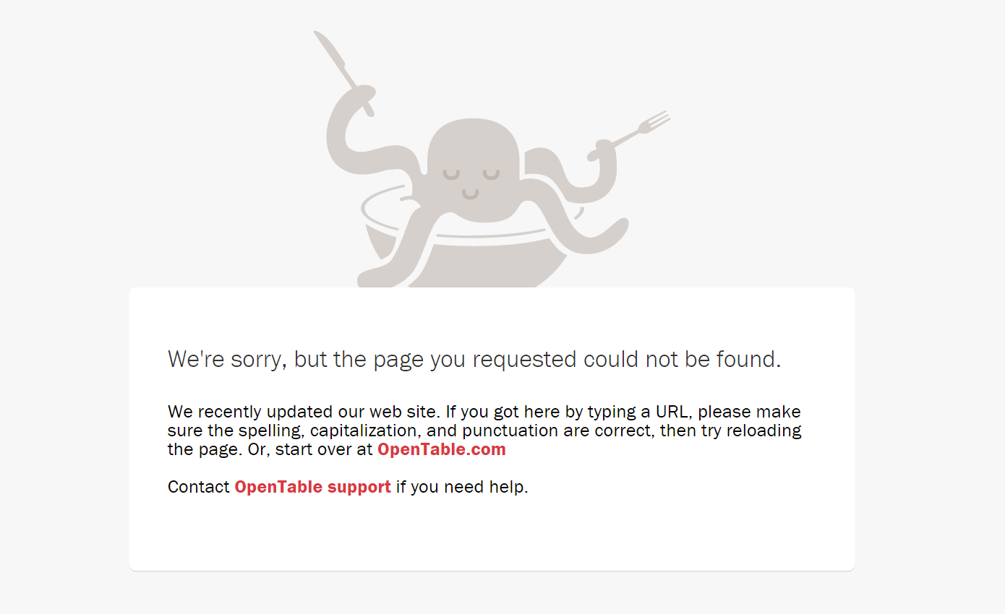
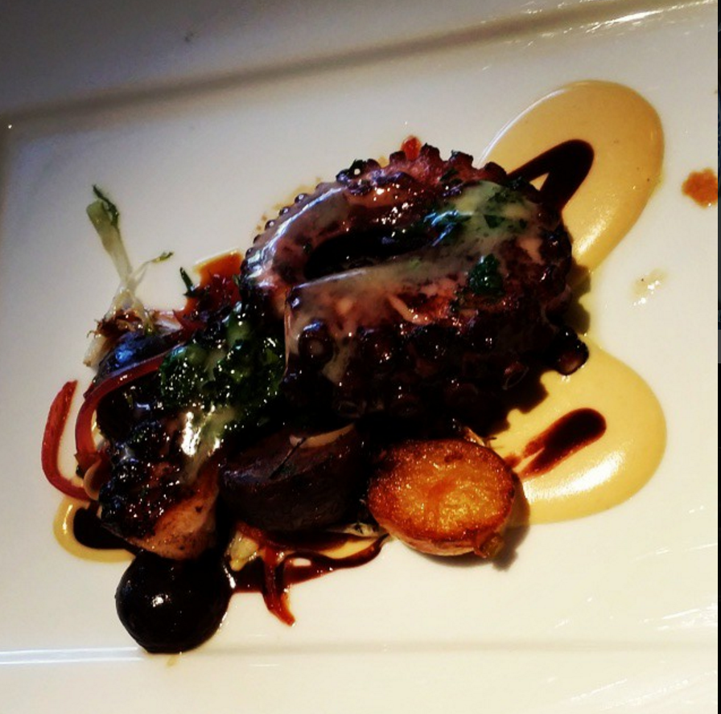
The Evil Octopus

Slide 7
The URL
www.opentable.com/ RestaurantName
www.opentable.com/r/ RestaurantName
www.opentable.com/r/RestaurantName-New-York
restaurantl = [re.sub('&', 'and',s) for s in restaurant]
restaurantl = [re.sub(' - ', '-', s) for s in restaurantl]
restaurantl = [re.sub(r'[^a-zA-Z0-9\s-]+', '', s) for s in restaurantl]
restaurantl = [re.sub(r'\s+', '-', s) for s in restaurantl]

Slide 8
I know this is New York. But…
Python unfortunately does NOT support accented letters ex: (á, é, í, ó, ú, ü, ñ)
xcuisine = driver.find_element(By.XPATH, '//*[@id="profile-details"]/div/div/div[1]/p[2]/span[2]').text
xcuisine = str(unicodedata.normalize("NFKD", xcuisine).encode('ascii','ignore'))

Slide 9
RoadMap
Purpose of This Project
Problems Encountered/ Solutions
The Map
Advantages?
Future Improvement

Slide 10

The Map

Slide 11
RoadMap
Purpose of This Project
Problems Encountered/ Solutions
The Map
Advantages?
Future Improvement

Slide 12
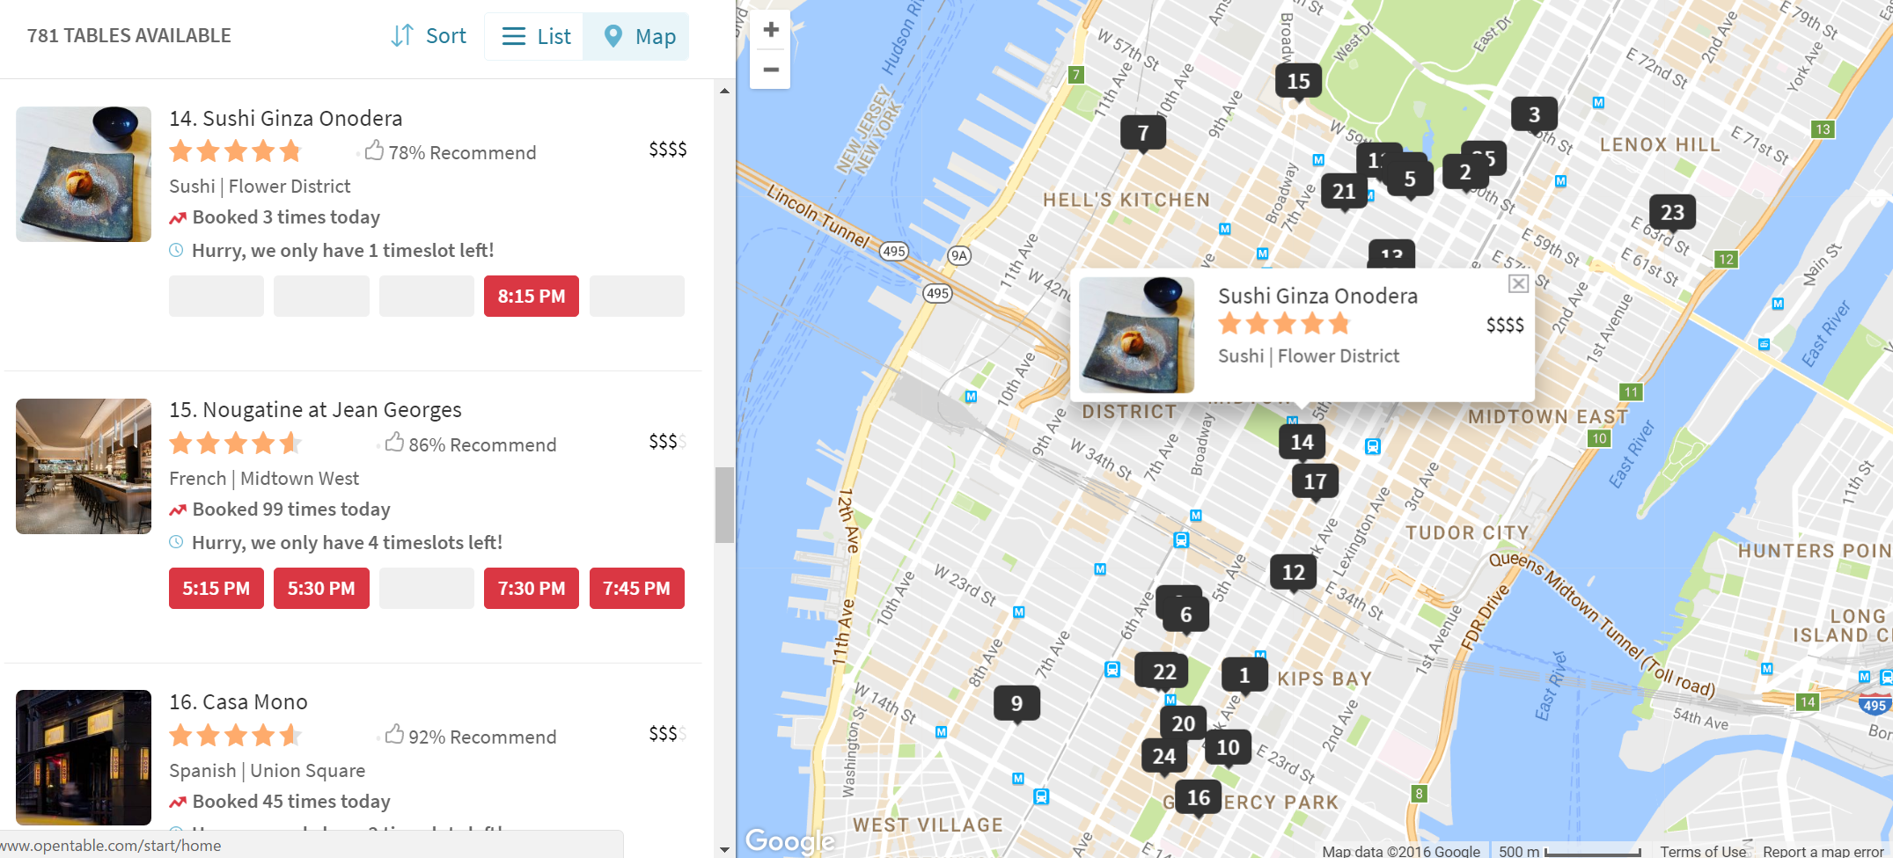
NONE
But Not For Long.

Slide 13
RoadMap
Purpose of This Project
Problems Encountered/ Solutions
The Map
Advantages?
Future Improvement

Slide 14
Planned Additions
Allow user input: Choose what time, what day to check (Multiple Inputs Too!)
Expand Beyond Manhattan
Be able to reserve instantly within the Map
Directions / Recommendations by Situation

